Slide 1
AlphaMet
for NanoWeatherSystem
①
②
③
④
① Synthetic Precipitation Data
High-resolution gridded precipitation data for ungauged sites (made from observation)
41 observational sites to make 35,112 point (250m res.) synthetic data
Similar to observation, substitution acceptable
② Nano Future Climate Change
Future Precipitation & 2m Temperature Changes(~2100) over Korean Peninsula
Simulation Based on the RCP 4.5, 8.5 Scenarios(AR4, 2007)
Horizontal Resolution : 1 km(Nano-Scale)
③ Real-time maritime incident response
Watching the weather conditions and chemical concentration over the sea surrounding Korea
A series of simulation for HNS behaviors with an automated downscaling up to 1km spatial resolution
④ Atmospheric Dispersion of Radionuclides
ICON-ART can simulate atmospheric dispersion of radionuclides.
It is possible to execute various experiments by specifying emission altitude, latitude, longitude, time, amount, etc.
PKNU
Supercomputer Center

Slide 2
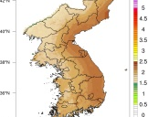
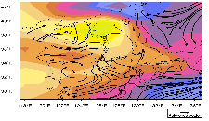
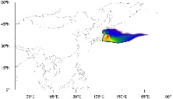
AlphaMet
for NanoWeatherSystem
①
②
②
③
④
① Synthetic Precipitation Data
High-resolution gridded precipitation data for ungauged sites (made from observation)
41 observational sites to make 35,112 point (250m res.) synthetic data
Similar to observation, substitution acceptable
② Nano Future Climate Change
Future Precipitation & 2m Temperature Changes(~2100) over Korean Peninsula
Simulation Based on the RCP 4.5, 8.5 Scenarios(AR4, 2007)
Horizontal Resolution : 1 km(Nano-Scale)
③ Real-time maritime incident response
Watching the weather conditions and chemical concentration over the sea surrounding Korea
A series of simulation for HNS behaviors with an automated downscaling up to 1km spatial resolution
④ Atmospheric Dispersion of Radionuclides
ICON-ART can simulate atmospheric dispersion of radionuclides.
It is possible to execute various experiments by specifying emission altitude, latitude, longitude, time, amount, etc.
PKNU
Supercomputer Center

